Slide 1

INSTITUTE : UIE
DEPARTMENT : CSE
Bachelor of Engineering (Computer Science & Engineering)
Mobile Application Development(20CST-355)
TOPIC OF PRESENTATION:
Building an App in Windows Phone 7, Mobile App Distributions
Prepared by:
Parveen Kumar Saini(E13339)
DISCOVER . LEARN . EMPOWER

Slide 2
Building an App in Windows Phone 7, Mobile App Distributions

Slide 3
Introduction to Windows Mobile 7 Development
Mobiletuts+ will be covering all major mobile platforms – iPhone, Windows, Android and Blackberry. Today we’ll be taking a look at Windows Phone 7 development. Windows Phone 7 is the latest mobile operating system from Microsoft. It is a clean break from previous Windows Mobile operating systems, such as WinMo 6.5, and offers .NET developers a chance to get in on the mobile application explosion that has happened in recent years. This tutorial will introduce you to the Windows Phone 7 platform, walk you through installing the SDK, and demonstrate the fundamental code necessary to build a simple application.

Slide 4
About the Platform
Windows Mobile 7 development is done using the .NET framework. The .NET framework is a software framework created by Microsoft for use in creating Windows applications. Programmers write applications using one of the several languages supported by the .NET framework, like C#, and the applications then execute inside of a runtime environment called the Common Language Runtime.
For Windows Phone 7, there are two distinct development approaches you can take when creating your application.
The first approach is to use Silverlight for Windows Phone. Silverlight was originally envisioned as a way for developers to create rich internet applications. It has seen a sharp increase in market adoption in recent years, driven mostly by the fact that Netflix uses Silverlight to stream videos and NBC used Silverlight for its online broadcast of the Olympic games. A Silverlight application combines declarative markup (called XAML) to construct the user interface and code written in a .NET framework language to control an application’s behavior. If you’re developing a data driven application for Windows Phone 7, you should probably use Silverlight.

Slide 5
Alternatively, you can use the XNA framework to develop your Windows Phone 7 app. XNA is Microsoft’s game development framework and has been used in recent years to create both Windows and Xbox 360 applications. If you’re creating a game for Windows Phone 7, you’ll likely use the XNA framework. The XNA framework is quite powerful, but that power comes with a considerable learning curve and longer development cycles.

Slide 6
Getting Set Up
Let’s get started by making sure your development environment is set up correctly. You’ll need to be running Windows Vista or Windows 7 and you need to have a DirectX 10 capable graphics card installed in your computer. After verifying that you meet these requirements, visit http://bit.ly/9FXxQC to download the development tools.
Scroll to the bottom of the page and download the file named VM_BOOT\vm_web.exe. Once the file has downloaded, double click on it to install the complete Windows Phone Developer Tools package.
The package includes:
Visual Studio 2010 Express for Windows Phone
Windows Phone Emulator
Silverlight for Windows Phone
XNA 4.0 Game Studio
Your computer will likely restart at least once while the tools are being installed. After you’ve installed the developer tools on your system, you are ready to get started.

Slide 7
Opening Visual Studio
The application you’ll create in this tutorial is a simple one. It displays a simple button that you can tap. When you tap it, the button rotates around the phone’s interface. We’ll develop this application using Silverlight for Windows Phone. It should take less than 10 minutes to create.
To begin, open Microsoft Visual Studio 2010 Express for Windows Phone. The easiest way to find it is to open the Start menu and begin typing “Visual Studio.” The application should show up in your search result list, similar to the following:
Click on the Visual Studio 2010 item to open up the development environment. If this is your first time opening the application, it may take a few minutes to start as Visual Studio will initialize some settings for you.

Slide 8
Creating Your Project
When you open Visual Studio, you’ll be greeted with the application’s start page. There is a lot of content on this page, including development tips, recent news, and project related actions. It is sometimes helpful to browse the content here to learn more about the platform, but for now just click on the “New Project…” link in the left sidebar.
A dialog box will pop up that guides you through creating your new project. Make sure the “Windows Phone Application” item is selected as your project template. Then, give your project a name. For this tutorial, I recommend calling your project “Rotating_Button.” Finally, confirm that the “Create directory for solution” checkbox is selected. This helps to organize your development efforts. Your settings should match mine:
Click “OK” to create your new project.

Slide 9
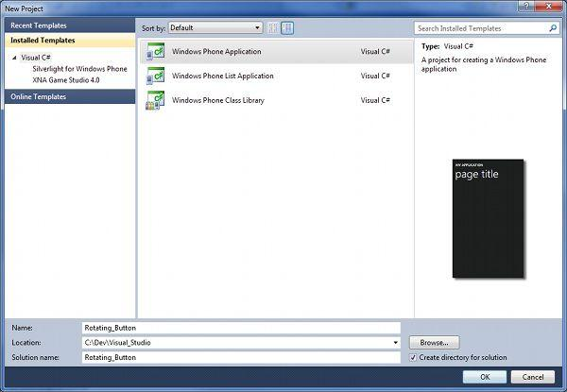

Slide 10
Navigating the UI Editor
The template that you’ve selected provides you with a completely working application. To see it in action, simply press CTRL+F5 to compile the application and launch it in the Windows Phone Emulator. The emulator launches with a single page containing an application title and a page title.
That default UI just won’t do for our application, so let’s make some modifications. Visual Studio should have opened the file MainPage.xaml for editing when you created the project. If not, double click the file’s name in the Solution Explorer to open it.
You should see a split screen view. On one side of the development environment you can see how the current file will look when your application is run. This is design mode. On the other side you have the XAML markup that declares how your interface should look. Any changes you make on one side will be represented on the other. This is similar to a WYSIWYG HTML editor like Dreamweaver.

Slide 11
The first thing we want to do is delete everything inside of the layout grid so we can provide our own markup. You should see a Grid tag named LayoutRoot. Delete everything inside this tag.
You’ll end up with the following code:
<Grid x:Name="LayoutRoot" Background="{StaticResource PhoneBackgroundBrush}">
</Grid>
The design mode view should show a blank screen at this point.

Slide 12
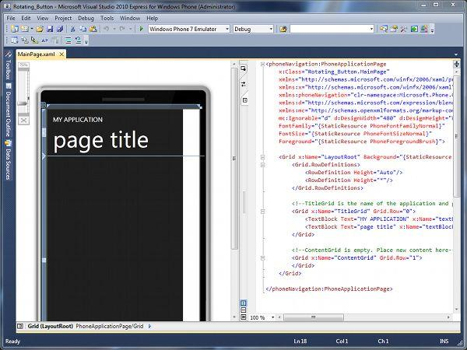

Slide 13
Creating Your Application’s Layout
You now need to add the UI for your application. Our application consists of a single button that will rotate around a grid. The grid is 2×2, so let’s go ahead and declare that the layout grid should have two rows two columns. Change your layout grid markup to the following:
<Grid x:Name="LayoutRoot" Background="{StaticResource PhoneBackgroundBrush}">
<Grid.ColumnDefinitions>
<ColumnDefinition Width="*" />
<ColumnDefinition Width="*" />
</Grid.ColumnDefinitions>
<Grid.RowDefinitions>
<RowDefinition Height="*" />
<RowDefinition Height="*" />
</Grid.RowDefinitions>
</Grid>

Slide 14
Adding the Button
After you’ve defined your layout grid, it is time to create the button that will be tapped by your users. You want the button to start in the upper left box of the grid, so you’ll declare that it goes in Row 0 and Column 0.
In XAML, you tell an element to place itself within a grid by declaring the element and then assigning it the appropriate row and column indices. Inside of your layout grid, add a button using the following markup:
<Button
Grid.Column="0"
Grid.Row="0"
Content="Tap Me!"
HorizontalAlignment="Stretch"
VerticalAlignment="Stretch"
/>
This markup says the button should position itself in column and row 0, should stretch both horizontally and vertically within the grid cell it occupies, and that it should have the text “Tap Me!”

Slide 15
Your application’s UI code should now resemble the following:
<Grid x:Name="LayoutRoot" Background="{StaticResource PhoneBackgroundBrush}">
<Grid.ColumnDefinitions>
<ColumnDefinition Width="*" />
<ColumnDefinition Width="*" />
</Grid.ColumnDefinitions>
<Grid.RowDefinitions>
<RowDefinition Height="*" />
<RowDefinition Height="*" />
</Grid.RowDefinitions>
<Button
Grid.Column="0"
Grid.Row="0"
Content="Tap Me!"
HorizontalAlignment="Stretch"
VerticalAlignment="Stretch"
/>
</Grid>

Slide 16
At this point, you can fire up your application and see that your UI is in place. Just like earlier, press CTRL+F5 to compile and launch your application in the Windows Phone emulator. If you’ve done everything correctly, you’ll see a button in your emulator nested firmly in the top left corner.
You can tap the button by clicking it with your mouse, but nothing will happen. We’ll remedy that next by adding some event handling code.

Slide 17
Build your first Windows Phone 7 app
Windows Phone 7 application development, download the tools and begin building a simple app from start to finish. From discovering the rich toolset, to writing XAML and C#, Microsoft MVP Michael Crump has you covered.
Knowledge needed: General C# and basic XAML
Requires: Visual Studio 2010 Express, Windows 7 Operating System, Windows Phone 7 SDK
Project Time: Two to four hours depending upon the speed of your internet connection and computer
Whether any of us like to admit it or not, mobile is here. It has been and will continue to be a core skillset that every developer will need to embrace. But how does someone new to mobile applications get started in mobile software development? Better yet, what if you have already built mobile applications on one platform and want to see the process of building an application on another one? This is what this article aims to accomplish. Get everyone up to speed with developing their first Windows Phone 7 application from start to finish.

Slide 18
Today we are going to get started developing applications for the Windows Phone 7 platform. Whether this is your first journey into mobile application development or you are just curious to see what developing an application on the Windows Phone 7 platform is like, then this article is for you. We are going to begin with downloading the tools required to build Windows Phone 7 applications, then dive straight into code and develop a simple, yet functional application. Let’s go ahead and get started.

Slide 19
01. Downloading the tools
Before we can get started developing for the platform, we will need to download and install several tools. I have listed the required tools below as well as a few extras to help speed up your development process.
Windows Phone Software Development Kit (SDK) 7.1(opens in new tab): This is the only required download and provides you with all of the tools that you need to develop applications and games for Windows Phone 7 devices. With the download, you can install Visual Studio 2010 Express (the IDE) which includes application templates for phone projects as well as productivity enhancements such as an app profiler and an improved emulator.

Slide 20
Windows Phone SDK Documentation: (opens in new tab)When building Windows Phone apps, you will be referencing pages from this site frequently. It contains documentation for the entire API as well as plenty of sample code.
Code Samples for Windows Phone:(opens in new tab) Now that you have the tools and documentation, you should download some sample applications. This page lists all of the sample applications that Microsoft has provided. It is broken down by features, so you can find the page you are looking for quickly and easily.

Slide 21
02. Our first Windows Phone application
Twitter is everywhere. It has become the new “Hello World” project for anyone learning a new platform and with good reason. It requires some sort of input control, event and error handling, web request and responses to formatting the data properly in your application. So, in this app we will build a Twitter application that allows the user to input a Twitter username and retrieve the tweets in a simple and easy to read format.

Slide 22
03. Construction begins
Author’s note: The screenshots listed below were recorded using Visual Studio 2010 Ultimate. If you are using Visual Studio 2010 Express for Windows Phone, then you may see some minor variations in menu commands or windows. However, the base functionality remains the same.
Now that we have downloaded and installed the tools, it is time to begin our first project. Open Visual Studio and select File -> New Project. Expand the Visual C# templates and select Silverlight for Windows Phone. Finally, select Windows Phone Application and give it a name as shown below.
Now, click OK and you will see this dialog box:

Slide 23
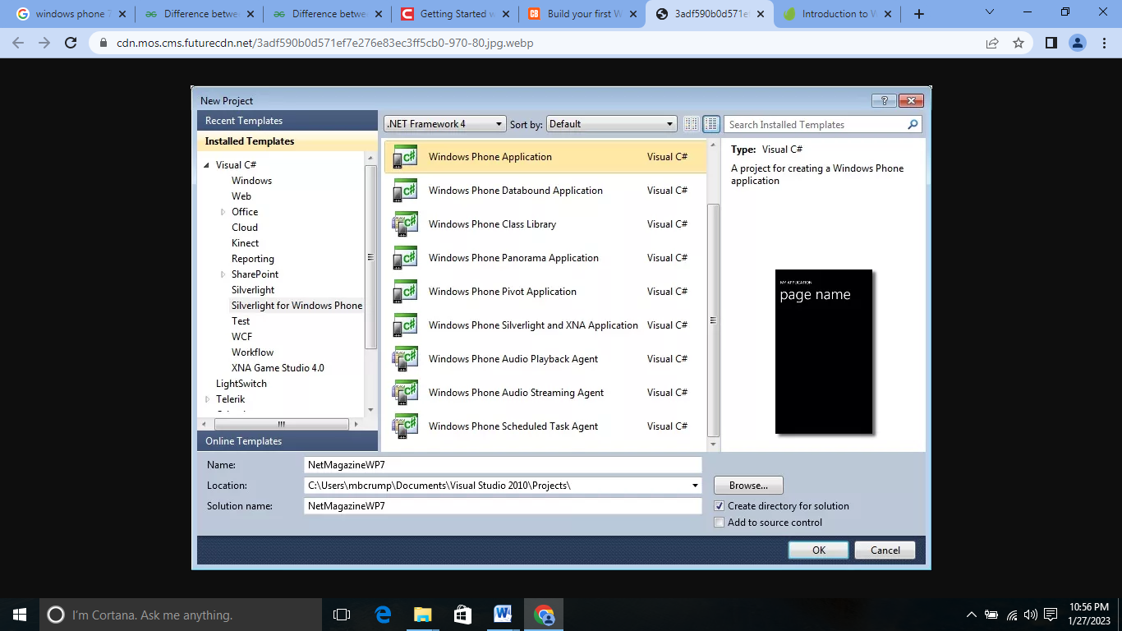

Slide 24
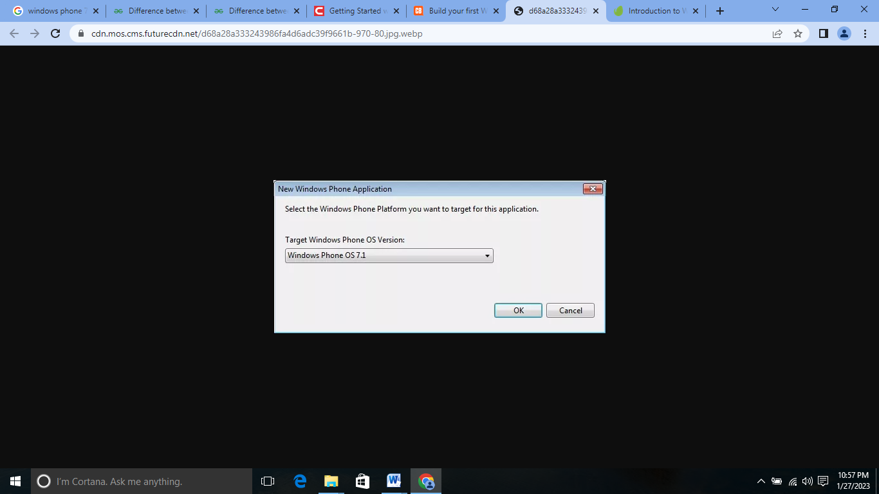

Slide 25
Dialog box asking the user which phone platform to target We have two options here:
Windows Phone OS 7.1: This is for Mango applications and includes an additional set of APIs for working with the Windows Phone. This is the default setting and should be used for new applications going forward.
Windows Phone OS 7.0: This is for the original version of the Windows Phone OS and should only be used in rare circumstances. Let’s go ahead and select Windows Phone OS 7.1 and select OK.

Slide 26
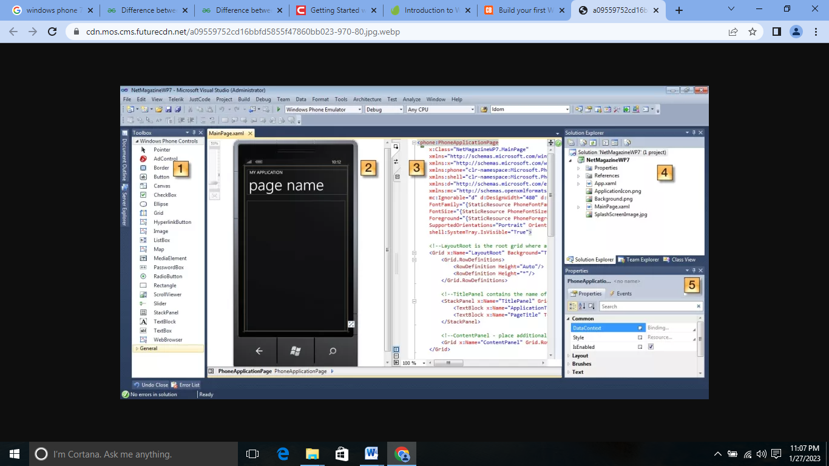

Slide 27
Once Visual Studio 2010 loads up, you will see the above screen.
The Toolbox contains Windows Phone Controls that you can add to your application. Samples includes: TextBox, Buttons, Images and more.
The Design View displays what your Windows Phone 7 application looks like real-time as you build the application.
The XAML View displays the current XAML that makes up the screen shown in #2.
The Solution Explorer Window displays all of the files that make up your application. This typically includes images and project files.
The Properties Window allows you to change certain characteristics of the controls added to the phone application.
04. Modify the existing app name and page title
The first thing we need to change is the default Application Name and Page Title to our own. Navigate inside of your MainPage.xaml (Shown in Figure #3, item #3) and modify the Text properties of each TextBlock as shown below:
<!--TitlePanel contains the name of the application and page title--> <StackPanel x:Name="TitlePanel" Grid.Row="0" Margin="12,17,0,28"> <TextBlock x:Name="ApplicationTitle" Text="MY TWITTER LOOKUP" Style="{StaticResource PhoneTextNormalStyle}"/> <TextBlock x:Name="PageTitle" Text="enter user" Margin="9,-7,0,0" Style="{StaticResource PhoneTextTitle1Style}"/> </StackPanel>
If you look at the designer window now, then you will see the following figure:

Slide 28
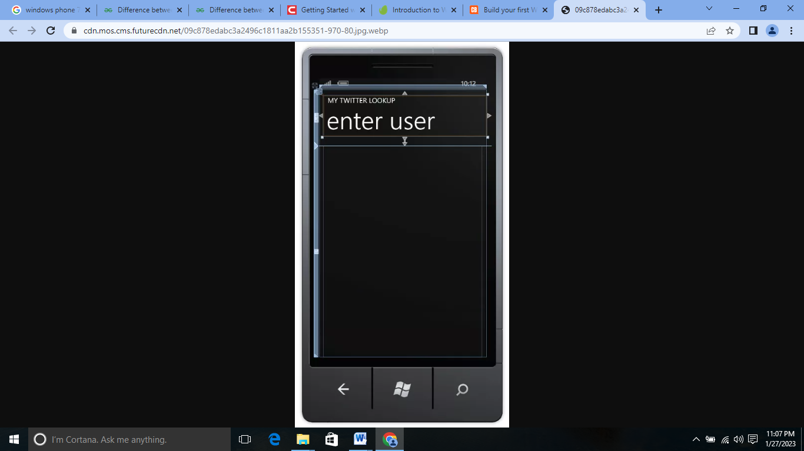

Slide 29
05. Adjusting layout and adding controls
The next thing that we will want to do is adjust the layout to allow our controls to fill the screen.
Move your mouse onto the designer and left click on the point shown in the grab below. This will allow us to fill this space with a TextBox and Button.
Adjusting the grid layout in a Windows Phone 7 application
Once that is in place, we will want to drag and drop a TextBox, Button and ListBox from the ToolBox onto the designer window as shown here:

Slide 30
So, what do these buttons do?
The TextBox is a user input control that will allow our user to type a Twitter username.
The Button will be pressed when the user is ready to lookup tweets from the user entered into the TextBox.
The ListBox will contain the users image as well as the tweet from the user.
Let’s go ahead and make the following modifications to the MainPage.xaml file.
Look for the

Slide 31
<!--ContentPanel - place additional content here--> tag and replace the code with the following:
<Grid x:Name="ContentPanel" Grid.Row="1" Margin="12,0,12,0"> <Grid.RowDefinitions> <RowDefinition Height="74*" /> <RowDefinition Height="533*" /> </Grid.RowDefinitions> <TextBox Grid.RowSpan="2" Height="72" HorizontalAlignment="Left" Margin="9,8,0,0" Name="txtUserName" VerticalAlignment="Top" Width="294" /> <Button Content="Lookup" Grid.RowSpan="2" Height="72" HorizontalAlignment="Left" Margin="296,8,0,0" Name="btnLookupUser" VerticalAlignment="Top" Width="160" Click="btnLookupUser_Click" /> <ListBox Name="lstTwitter" Grid.Row="1" Margin="10, 10, 10, 10"> <ListBox.ItemTemplate> <DataTemplate> <StackPanel Orientation="Horizontal" Height="110" Margin="-10,-10,-10,-10"> <Image Source="{Binding ImageSource}" Height="73" Width="73" VerticalAlignment="Top" Margin="10,10,8,10"/> <TextBlock Text="{Binding Message}" Margin="10" TextWrapping="Wrap" FontSize="18" Width="350" /> </StackPanel> </DataTemplate> </ListBox.ItemTemplate> </ListBox> </Grid>

Slide 32
Button: We also gave it a name and changed the Content property to Lookup. We finally added a Click event handler to fire when the user presses the button
TextBox: We gave it a name and deleted the Text property. This will allow us to refer to the TextBox when the user presses the button.
ListBox: This control had the most drastic of changes, we added a name and then a ListBox.ItemTemplate. The ItemTemplate determines the layout of each item in the list. You then associate DataTemplates with those data elements to define what UI elements are used to render them.
In this case, we are using a StackPanel which stacks elements in a direction. We horizontally stack an image and a TextBlock to display the image of the user and his/her tweet.

Slide 33
06. Time to code
Now that we have added XAML to our project, it is time to add some code behind to our page to make the application function.
Let’s begin by adding a reference to an existing file built by Microsoft to help us parse the XML returned by the Twitter API we will be using.
Right click on References, and select Add Reference. Scroll down through the list until you get to System.Xml.Linq and select OK as shown here:
Add references dialog to Windows Phone 7 project
Now that we have the proper library in place, we will add a new class which contains the Twitter items.
Right-click on your project and select Add, then Class. Let’s give it the name of TwitterItem and press return. Inside of that class, we will add two properties as shown below which will contain our ImageSource and Message.

Slide 34
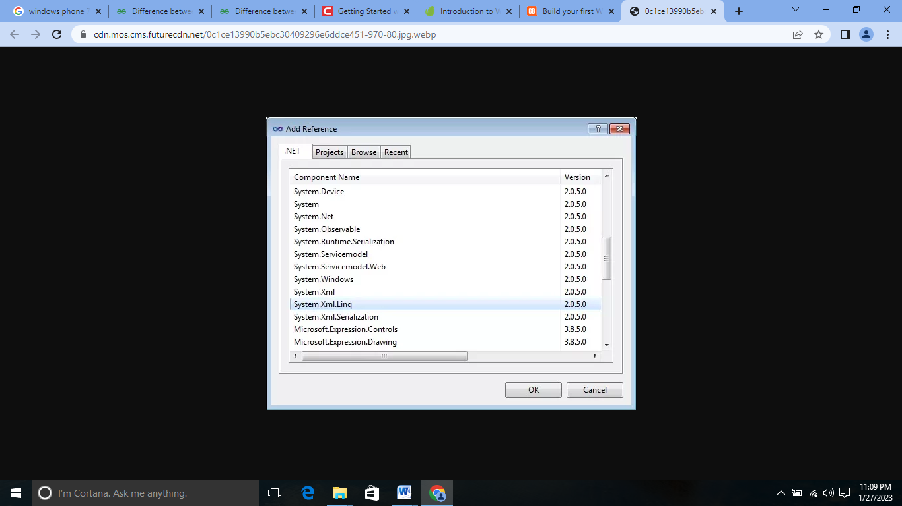

Slide 35
Add references dialog to Windows Phone 7 project
Now that we have the proper library in place, we will add a new class which contains the Twitter items.
Right-click on your project and select Add, then Class. Let’s give it the name of TwitterItem and press return. Inside of that class, we will add two properties as shown below which will contain our ImageSource and Message.

Slide 36
07. Ready for launch
Now that we have our application built, it's time to launch it and see it in action. The first thing we are going to need to do is make sure the target is set to Windows Phone Emulator as shown here:
Setting the target type to Windows Phone Emulator
Note: If you had a Windows Phone device and an App Hub membership, then you could change the drop-down to Windows Phone Device.
Once the application loads, then you will see the following screen:

Slide 37
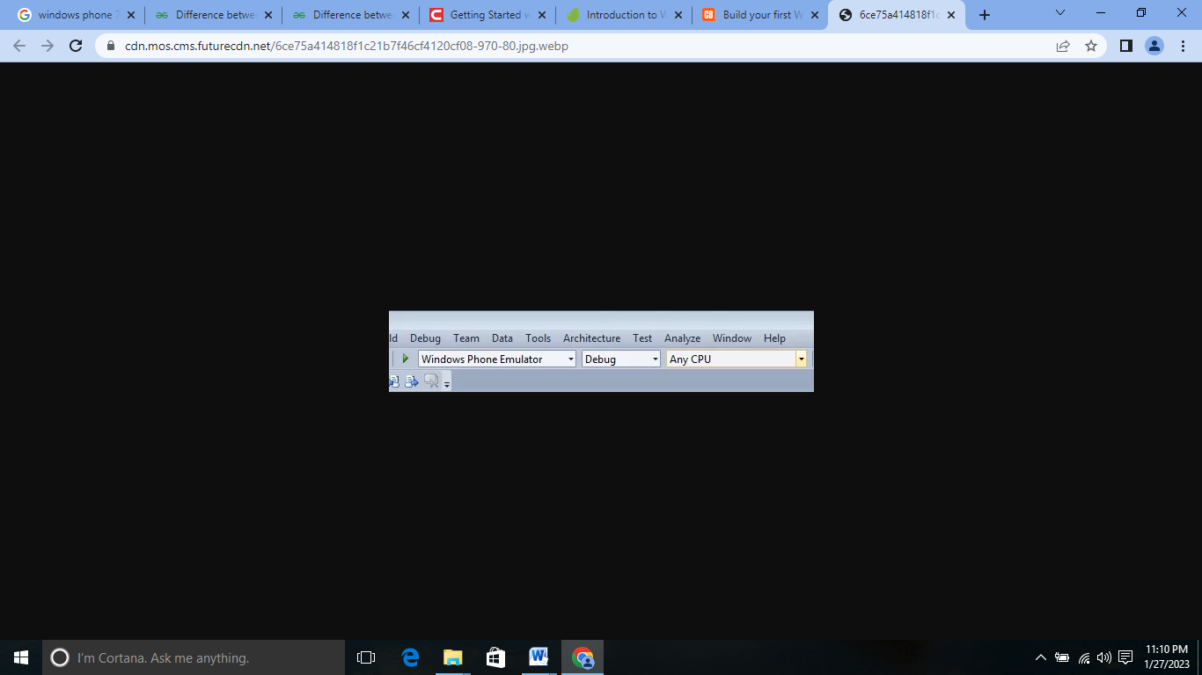

Slide 38
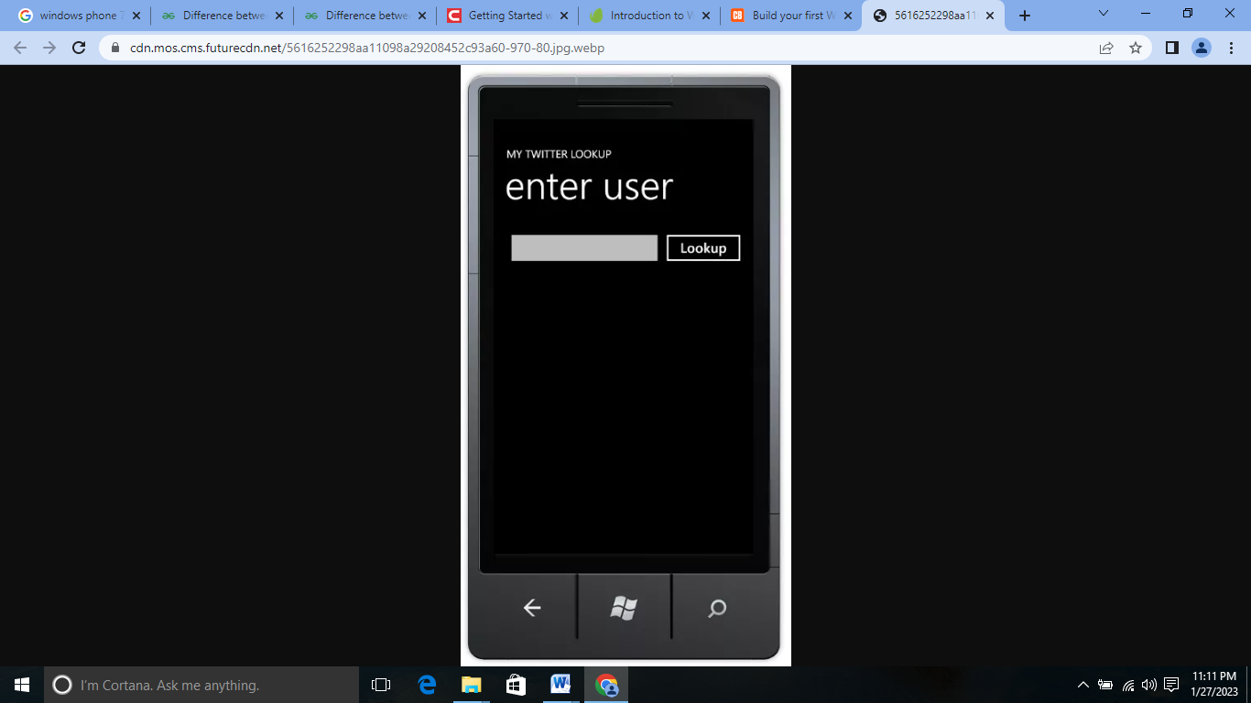

Slide 39
The Windows Phone application on first launch
Go ahead and select the TextBox and you will see the software keyboard. You can optionally press page up to use the keyboard on your computer to type. Give it any valid Twitter Username and select Lookup.
The application will return the tweets from the specified user as shown here:

Slide 40
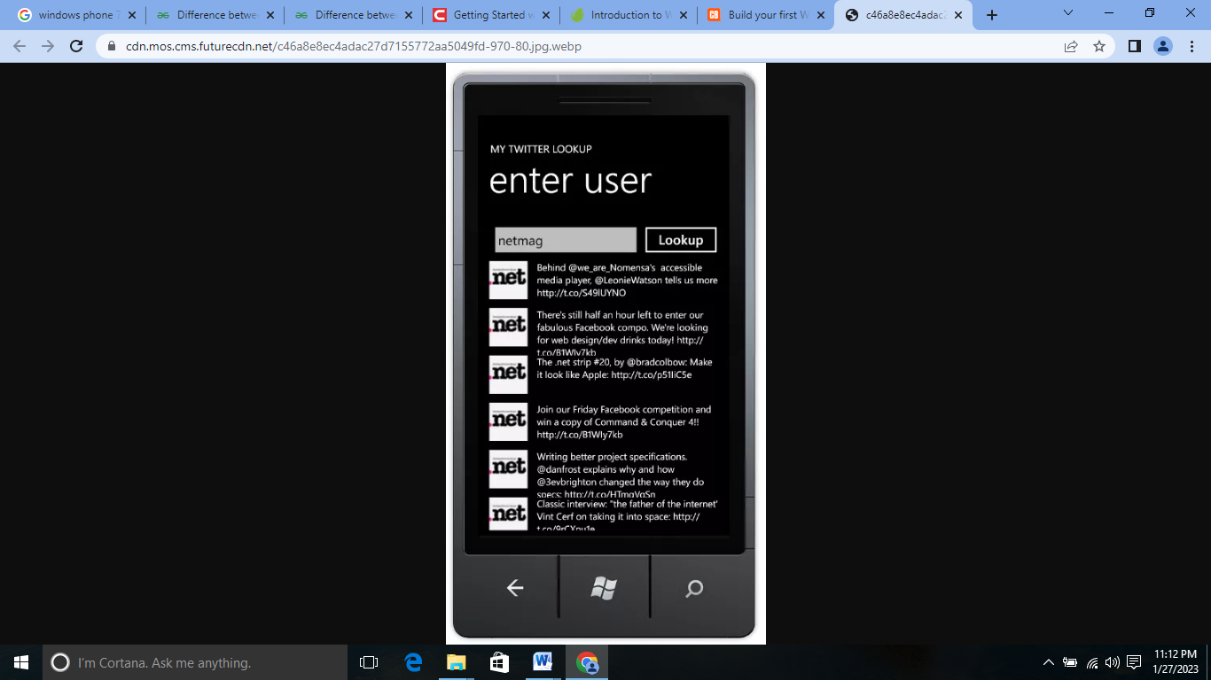

Slide 41
The final application returning tweets from a username provided by a user Your users could also switch to the Light theme built into the setting menu of Windows Phone 7 and the application’s colours would adjust automatically as shown below.
The Light Theme displaying our application that we built
It's important to note that this sample application should contain additional error handling. I excluded them from the demo for the sake of learning purposes

Slide 42
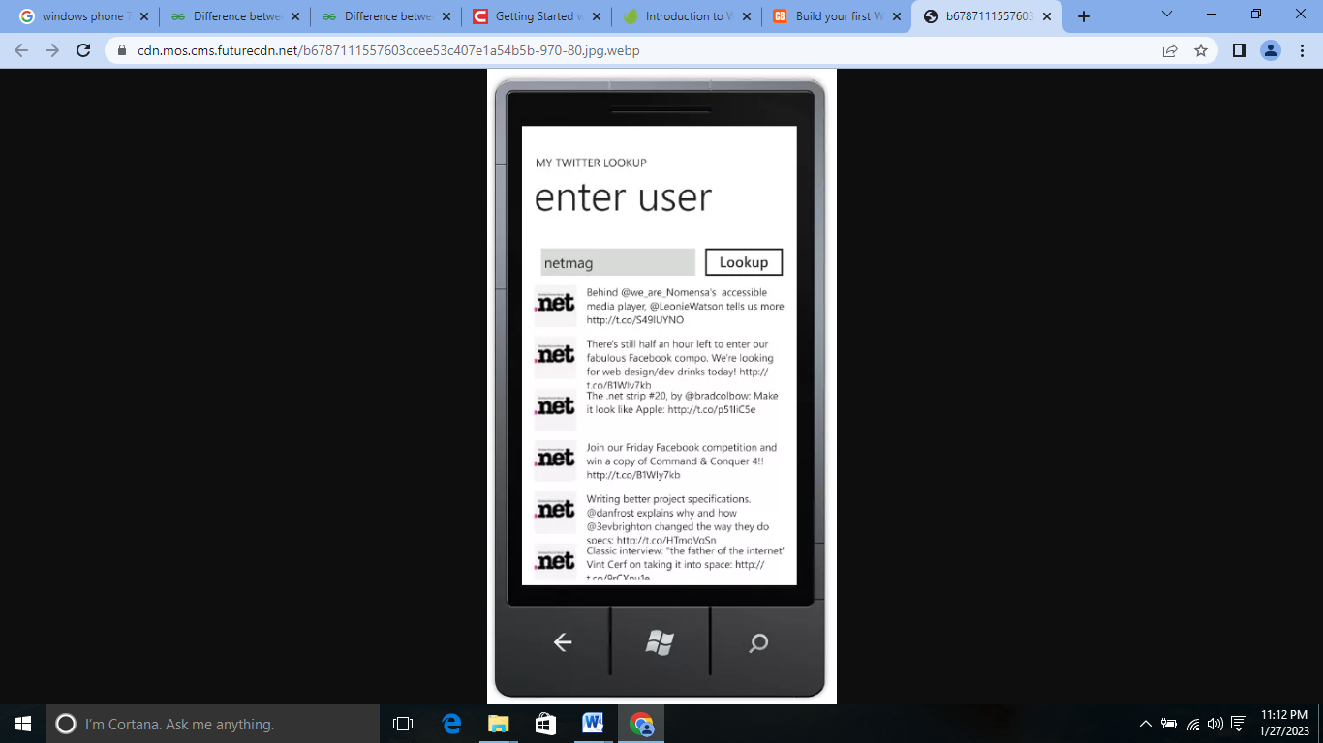

Slide 43
7 Most Popular Mobile App Distribution Platforms And Related Stats2
1. Amazon Appstore
2. Samsung Galaxy Apps
3. Google Play Store
4. Blackberry World
5. Apple App Store
6. Firefox Marketplace
7. Microsoft Windows Store

Slide 44
Building an App Distribution Strategy
1. Targeting multiple channels & platforms
2. Avoid non-performing platforms
3. Consistent channel optimization
4. Determine niche app distribution channels

Slide 45
Top Mobile App Distribution Channels for Businesses
1. App Stores/Recommendation Sites
2. Pre-Loads
3. Ad Networks
4. Pay-Per-Installs
5. App Giveaways
6. Create a Mobile Web Version of Your App

Slide 46
THANK YOU
For queries
Email: parveen.e13339@cumail.in

